Slide 1
RF noise analysis

Slide 2
Brief conclusion
If we make the following adjustments, we can lower the noise to signal ratio from 1.29*10⁻⁵ (48.89 dB) to 1.67*10⁻⁶ (57.76 dB).
Change the reference chip into the lower noise one.
Lower the resistance of the resistors in the non-inverting amplifier from 240 kOhm and 20 kOhm to 8 kOhm and 2 kOhm. In this adjustment we also lower the gain from 13 to 5.
Increase the gain of the differential amplifier from 8 to 20 (40 kOhm and 2 kOhm)
Increase the signal voltage from 0.35V to 0.955V

Slide 3
Measuring reference chip noise

Slide 4
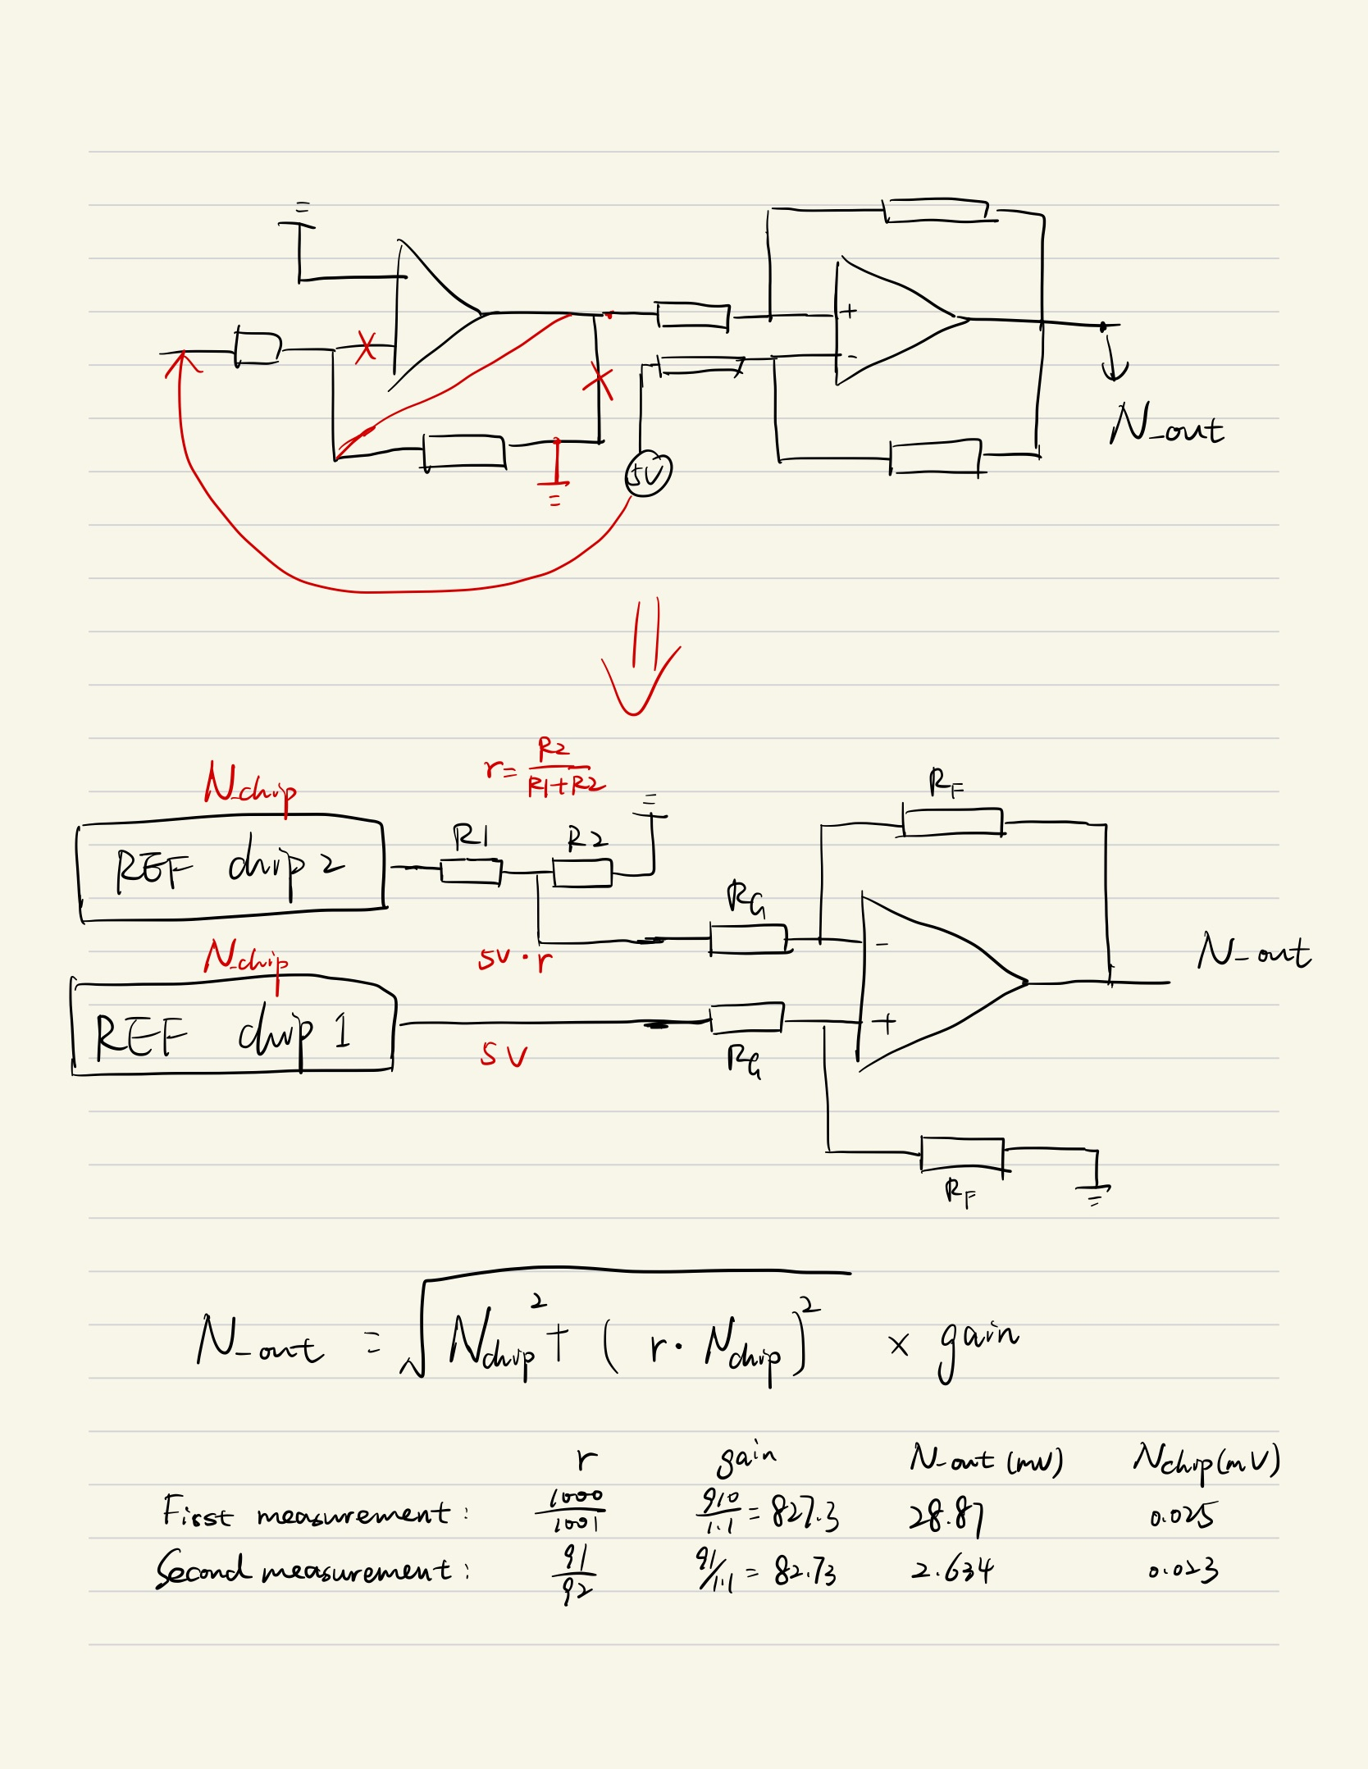
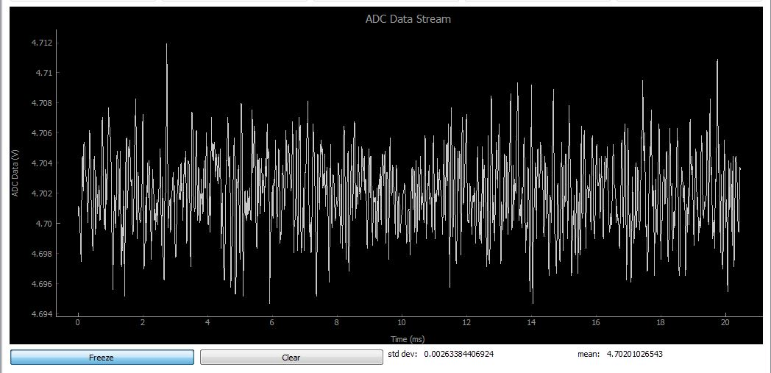

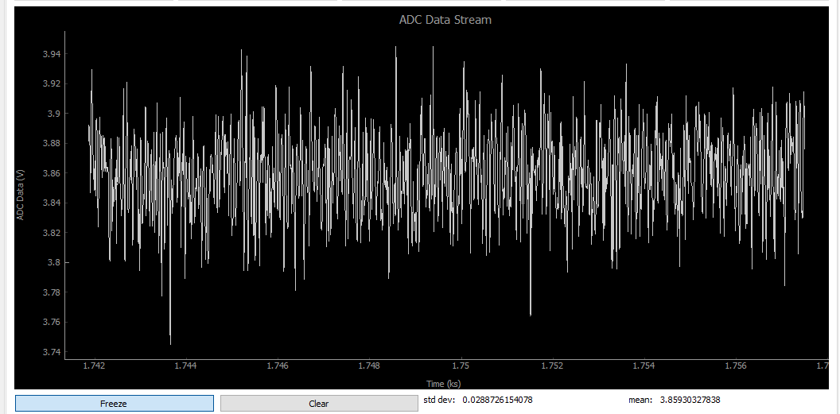

Measure the reference chip noise

Slide 5
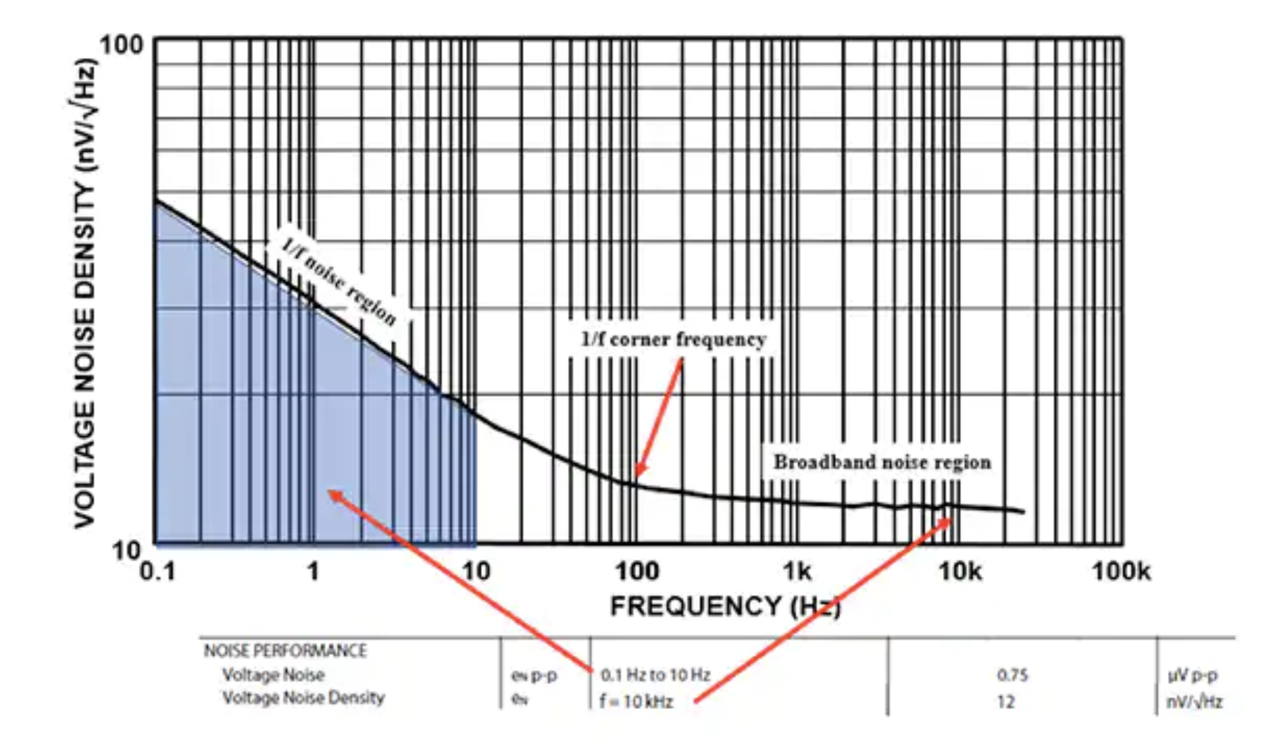
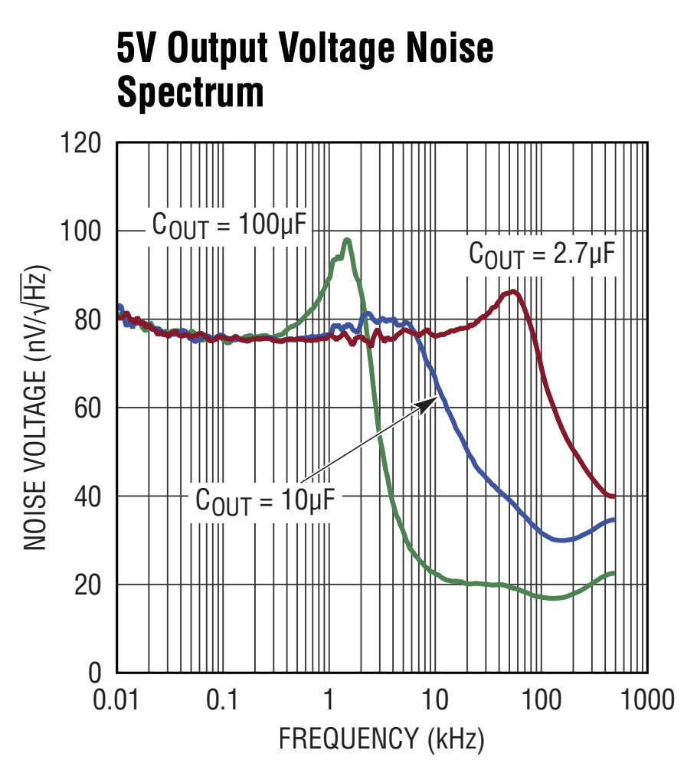
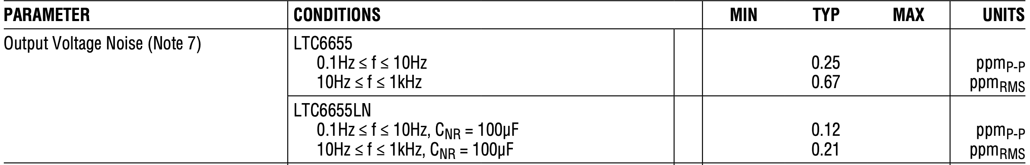
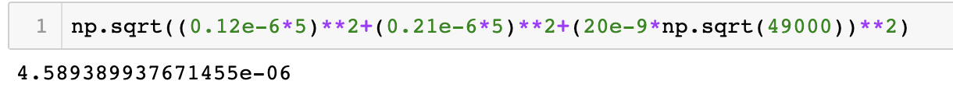
The datasheet of new reference chip
Lower noise reference chip: LTC6655LN
https://www.analog.com/media/en/technical-documentation/data-sheets/ltc6655-6655ln.pdf
Previous one: 25 uV
This one: 4.6 uV

Slide 6
Simulation results

Slide 7
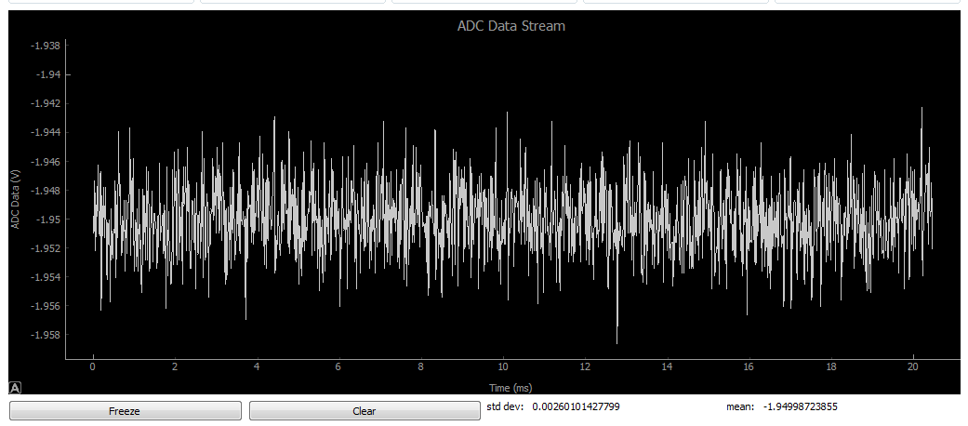
Before changing opamps (measured)

Slide 8
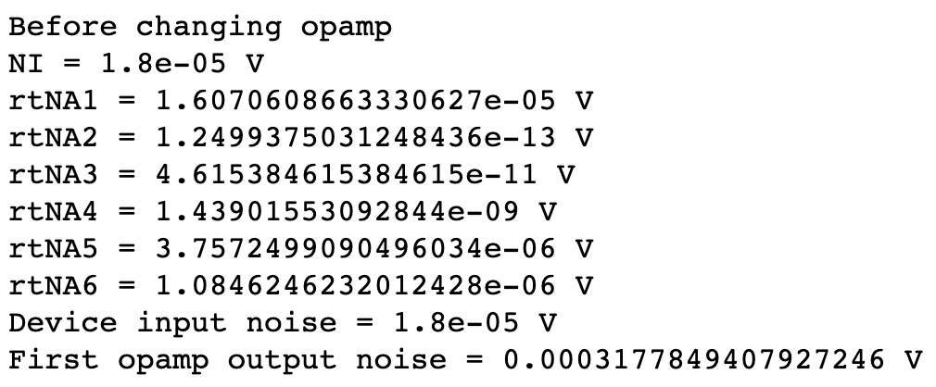
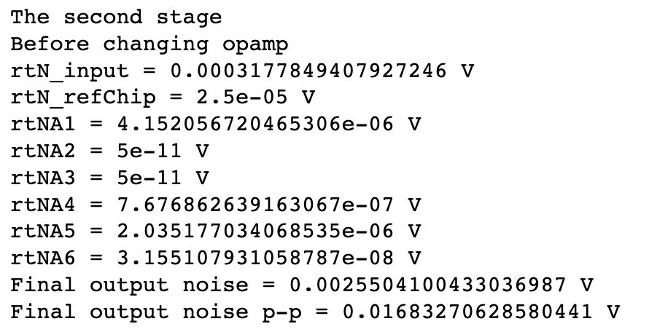
Before changing opamps (simulated)
The first stage is a non-inverting amplifier, whose dominant noise comes from the input noise of the opamp itself and the DAC noise.
The second stage is a differential amplifier, whose dominant noise comes from the noise of the first amplifier.
Measured noise is 2.60 mV, calculated noise is 2.55 mV

Slide 9
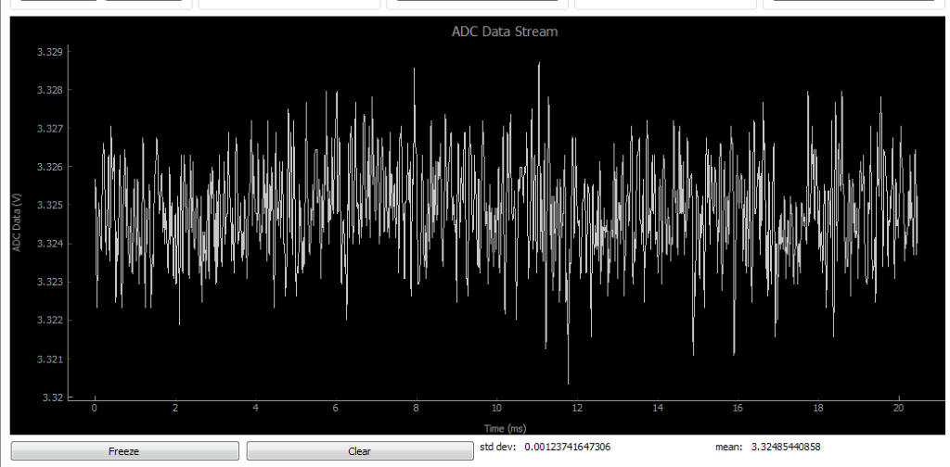
After changing opamps (measured)

Slide 10
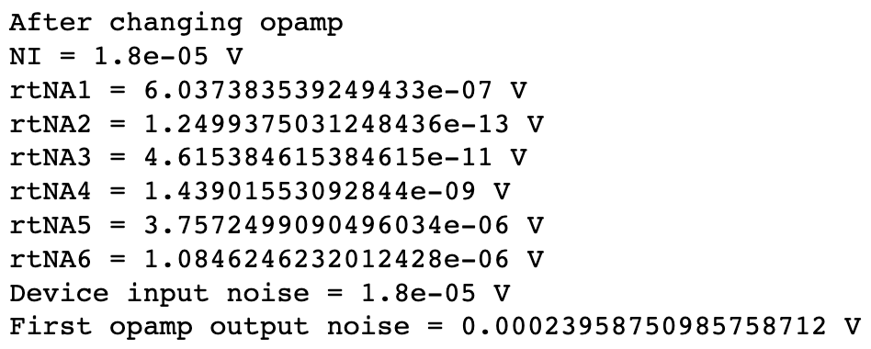
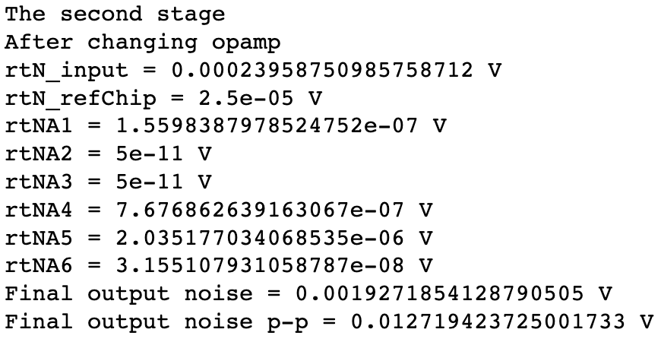
After changing opamps (simulated)
The first stage is a non-inverting amplifier, whose dominant noise comes from the the DAC noise.
The second stage is a differential amplifier, whose dominant noise comes from the noise from the first amplifier.
Measured noise is 1.23 mV, calculated noise is 1.92 mV

Slide 11
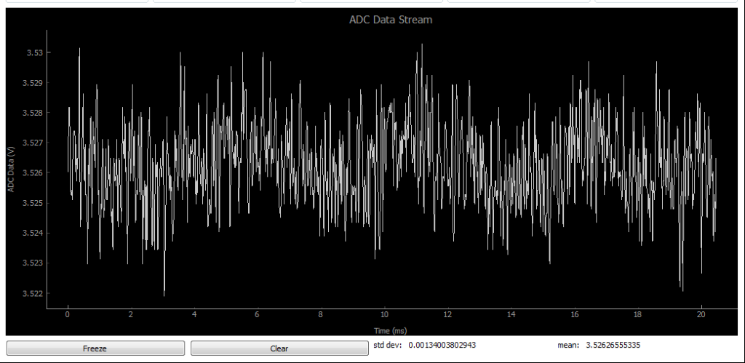
Test: Lower the resistance (measured)

Slide 12
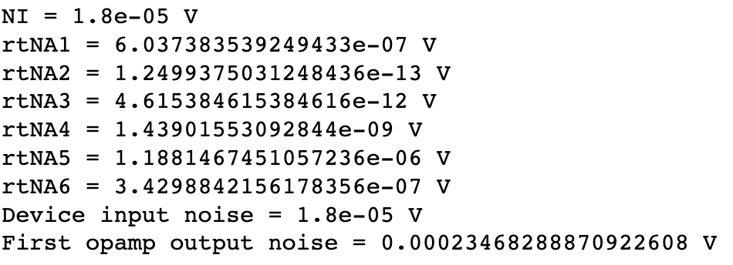
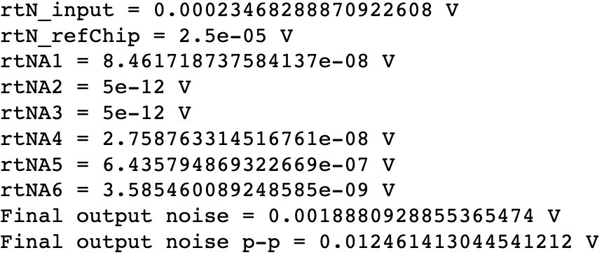
Test: Lower the resistance (simulated)
The first stage is a non-inverting amplifier, whose dominant noise comes from the the DAC noise.
The second stage is a differential amplifier, whose dominant noise comes from the noise from the first amplifier.
Measured noise is 1.34 mV, calculated noise is 1.89 mV

Slide 13
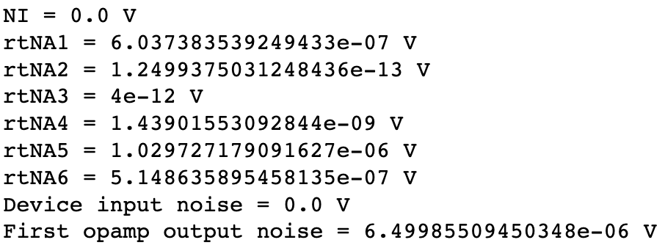
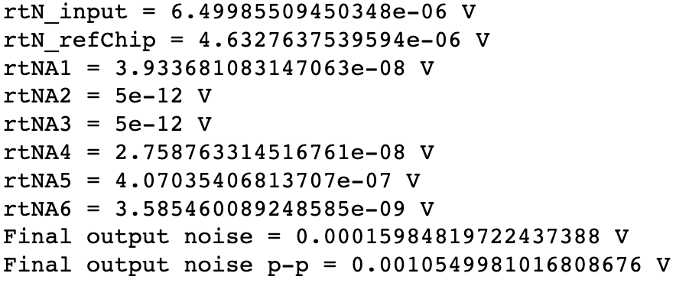
Proposed condition
Change the reference chip into the lower noise one.
Lower the resistance of the resistors in the non-inverting amplifier from 240 kOhm and 20 kOhm to 8 kOhm and 2 kOhm.
Increase the gain of the differential amplifier from 8 to 20 (40 kOhm and 2 kOhm)
Increase the signal voltage from 0.35V to 0.955V.
The dominant noise of the first stage becomes the opamp and resistors. Further lowering the resistance will result in mismatching
The dominant noise of the second stage is the reference chip and the first stage noise, but with a lower level.
The noise to signal ratio is 1.67*10⁻⁶. The SNR is 57.76 dB.

Slide 14
Setting input noise as zero
 | Before changing Opamp | After changing Opamp | After changing Opamp and decrease the resistance | Proposed conditions
Dominating noise in the first stage | Opamp (LTC2051) | Resistors | Resistors | Opamp (AD8655) and resistors
Value (V) | 1.61 e-5 | 3.76 e-6 | 1.19 e-6 | 6.04 e-7 & 1.03 e-6
Dominating noise in the second stage | Noise from the first opamp | Noise from the first opamp | Reference chip (REF50xx) | Reference chip (LTC6655) & noise from last opamp
Value (V) | 2.15 e-4 | 5.14 e-5 | 2.50 e-5 | 4.63 e-6 & 6.50 e-6
Final Noise (V) | 1.73 e-3 | 4.6 e-4 | 2.5 e-4 | 1.60 e-4
Noise to signal ratio | 4.88 e-5 | 1.29 e-5 | 6.93 e-6 | 1.67 e-6
SNR (dB) | 43.12 | 48.89 | 51.59 | 57.76
SNR (dB) after adding ADC noise (8 e-5 V) | 43.12 | 48.81 | 51.31 | 57.27

